Slide 1
Initial Legal Considerations When Establishing a Business in Texas Presentation to DEÏK / TAÏK Istanbul, Türkiye James Prappas 5 October 2023

Slide 2
Overview
Choice of Entity/Tax
Employment Issues
Intellectual Property
Real Estate (Lease or Purchase)
U.S. Immigration
Team of Trusted Advisors

Slide 3
Choice of Entity/Tax
Selecting a Business Structure
The Limited Liability Company – the most common business entity type for most businesses.
Default choice unless there is a unique circumstance to which another entity would be more beneficial
Why?
Robust protections for the members of the LLC
Flexibility in management
Members may enjoy the pass-through tax treatment afforded to partners in a partnership
LLC can achieve both structural flexibility and favorable tax treatment
Filing with the Secretary of State
Filing fees to form an entity are flat rated.
Non-U.S. Entities and Non-Texas Entities
Non-U.S. corporations, LLCs, LPs and financial institutions must register with the secretary of state before transacting business in Texas.
Licenses or Permits

Slide 4
Employment Issues
Engaging Workers in the U.S. and Texas
Independent Contractors vs. Employee
Protecting Proprietary Information and Business Relationships.
Non-Disclosure – protect confidential data
Non-Solicitation–protect relationships
Non-Competition–protect goodwill

Slide 5
Intellectual Property (IP)
Soft IP
Trademark Registration through the USPTO
Trademarks protect a company's product or services; however, it is not formally "on the books" unless it is a registered trademark filed with the US Patent and Trademark Office (USPTO).
Copyright Protection
Copyrights are most often used to protect creative works such as writing, music, or photographs.
Hard IP
Filing Patents with the USPTO
Patents protects innovation.

Slide 6
Real Estate (Lease or Purchase)
Leases
Review the lease for unfavorable terms for the tenant
Hidden Fees
Entitlements or Zoning(authorized uses of the property)
Events of Default
Assignment and Subletting
Purchase
Entitlements (authorized uses of the property)
Due Diligence
Lending

Slide 7
U.S. Immigration
Pre Set-Up Considerations
Use Visa Waiver – 90 days or B-1 visa to prepare a business plan before establishing the U.S. entity.
Visitor for business does not allow productive employment. E.g. the duck. If it looks like a duck, quacks like a duck, it’s a duck. Same for “work.”
B-1 visa allows time to understand the U.S. market and develop a realistic plan for success.

Slide 8
U.S. Immigration (continued)
Temporary Visa Options include
E-1 Treaty Trader
E-2 Treaty Investor
L-1A Intracompany transferee – L-1A manager or Executive & L-1B specialized knowledge
Also consider spouse issues and remember passport validity

Slide 9
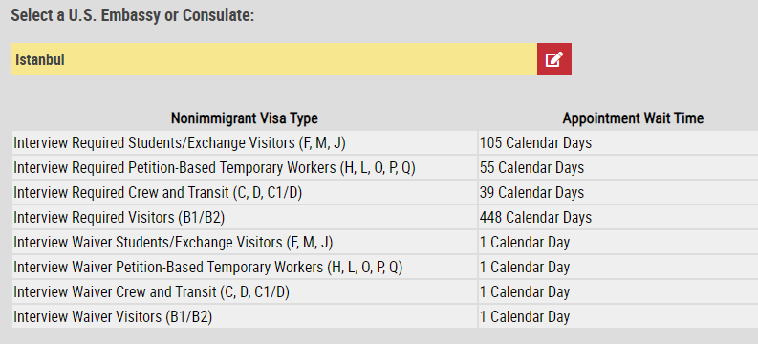
U.S. Immigration (continued)
Timing
See Istanbul see - https://travel.state.gov/content/travel/en/us-visas/visa-information-resources/wait-times.html
As of Oct. 2, 2023, the E visa processing time for the U.S. Consulate Istanbul, the reported time is July 2025. There may be an opportunity to ask for an expedite.

Slide 10
U.S. Immigration (continued)
Diversity Visa Lottery
See https://travel.state.gov/content/travel/en/us-visas/immigrate/diversity-visa-program- entry/diversity-visa-instructions.html which states in part as follows - DV-2025 Program: Online Registration
DV-2025 Program: The online registration period for the DV-2025 Program begins on Wednesday, October 4, 2023, at 12:00 noon, Eastern Daylight Time (EDT) (GMT-4) and concludes on Tuesday, November 7, 2023, at 12:00 noon, Eastern Standard Time (EST) (GMT-5). Submission of more than one entry for a person during the registration period will disqualify all entries for that person.
See also https://travel.state.gov/content/dam/visas/Diversity-Visa/DV-Instructions-Translations/dv-2025-instructions-translations/DV-2025_Instructions-faqs.pdf
Note there are many considerations related to applying for lawful permanent residence aka green card including but not limited U.S. and international estate planning and tax issues.

Slide 11
Team of Trusted Advisors
Planning is vital for success
Keys to success - Legal, Accounting/CPA and financial advisors - banker and insurance
Identify your customers and the market
Sufficient capital for start up operations

Slide 12
Questions?

Slide 13
Thank you!
James Prappas
Kane Russell Coleman Logan
5151 San Felipe Street, Suite 800
Houston, Texas 77056
Office (713)425-7431
Cell (713) 504- 9018
Jprappas@krcl.com
www.krcl.com

